Slide 1
BRITISH AIRWAYS REPORT
INSIGHTS ON THE FEEDBACK OF CUSTOMERS

Slide 2
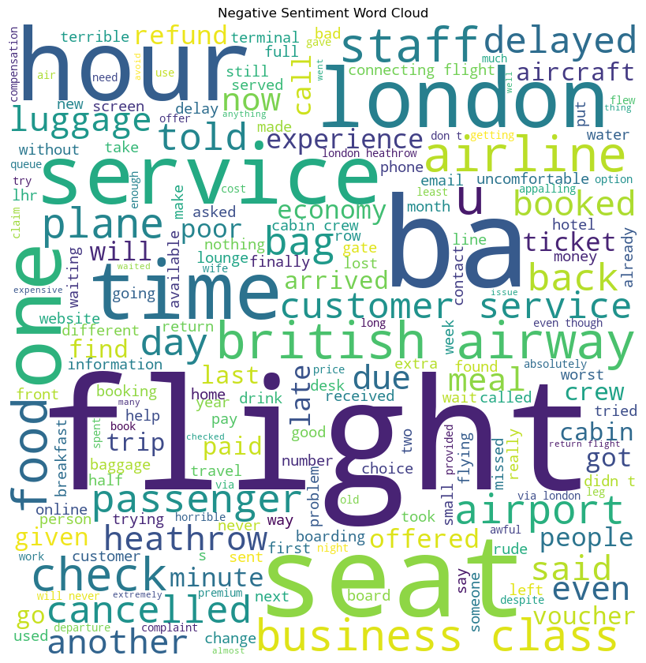
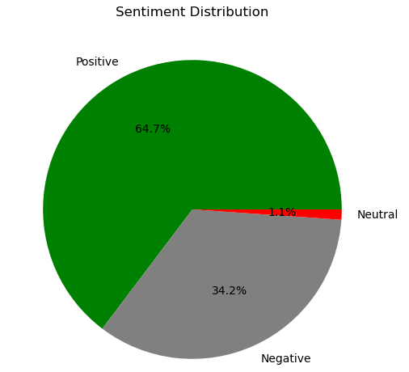
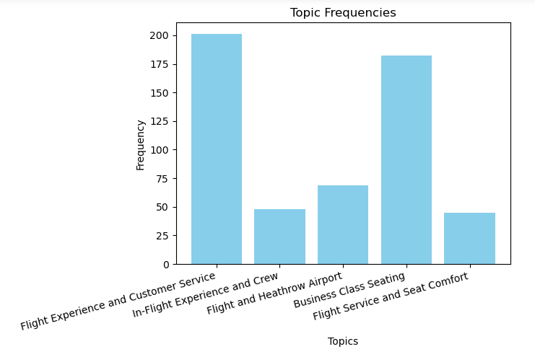
FINDINGS ON CUSTOMER FEEDBACK
It was observed that 64.7% of the feedbacks were positive, 1.1% were neutral and 34.2% were negative.
Customers want business class seating to be looked at together with customer service and flight experience.

